Slide 1
Model Testing, Regression & TEVV
Chapter 06 · Episode 1 — Dr. Michael Solomon

Slide 2
Three Testing Cadences
Pre-deployment — full suite before architecture review closes
Periodic production — tier 1 quarterly, tier 2 semiannual
Incident-triggered — out-of-cycle before return to operation

Slide 3
What This Episode Proves
Why accuracy alone is insufficient for security
Security-aware evaluation metrics
Adversarial robustness testing
Evaluation as a continuous control, not a one-time gate

Slide 4
ACCURATE ≠ SECURE
Accuracy = average performance on the test distribution
Security = resilience under adversarial pressure
A 97%-accurate IDS can still be trivially evaded

Slide 5
Metrics Must Reflect Asymmetry
A false positive inconveniences; a false negative enables a breach
Precision & recall matter more than overall accuracy
FN rate on highest-severity threats = security posture

Slide 6
Independent Evaluation Data
Train/eval independence is non-negotiable
Holdout sets are the only honest baseline
Cross-validation catches overfitting holdout misses

Slide 7
Evaluation Bias
Clean lab data fails on noisy production data
Include edge cases, out-of-distribution inputs, realistic noise
Why models that pass testing degrade after deployment

Slide 8
Adversarial Robustness Testing
Adversarial-example testing probes decision boundaries
Stress testing — unusual formats, extreme/ambiguous inputs
Red teaming — injection, prompt extraction, jailbreak, leakage
Guardrail validation under adversarial pressure

Slide 9
Bias, Fairness & Explainability
Bias is a security vulnerability — a known evasion path
Inconsistent fairness is what attackers look for
Explainability enables root-cause of unexpected outputs

Slide 10
Evaluation Is Continuous
Not a pre-deployment gate — a continuous control
Post-deploy monitoring: drift, confidence, anomaly rates
Regression test after retrain, fine-tune, prune, quantize
Each optimization is a new deployment event

Slide 11
TEVV = DEPLOYMENT GATE
Findings above threshold become risk-register entries
V&V completion gates the architecture-review checklist
Mandatory for high-risk AI under the EU AI Act

Slide 12
Encryption: Data at Every Stage
Training data, model artifacts, inference — all sensitive
Three states: at rest, in transit, in use
The exam tests all three independently

Slide 13
Encryption at Rest
Encrypt training data, corpora, vector DBs, model weights
Storage-level + application-level layers
Key governance: isolate keys from data; KMS rotation
Readable data on stolen media = at-rest failure

Slide 14
Encryption in Transit
TLS for all distributed AI communication — a rule, not advice
Mutual authentication for service-to-service
Certificate-lifecycle management; zero-trust internally
Intercepted traffic = in-transit failure

Slide 15
Encryption in Use
Confidential computing / trusted execution environments
Isolates memory in multi-tenant cloud
Homomorphic encryption — compute on encrypted data
Leakage despite rest + transit = in-use lacking

Slide 16
Key Governance & Lifecycle
Key rotation, revocation, crypto-operation logging
Regulatory alignment for protected data categories
Encryption without key governance is insufficient
One layer of defense-in-depth, not a standalone answer

Slide 17
Recap · Testing & TEVV
Five testing categories: functional, performance, adversarial, fairness, regression
TEVV + the V&V distinction
Regression testing is a mandatory gate after every material change

Slide 18
Data Management Controls & Data Poisoning
Chapter 06 · Episode 2 — Dr. Michael Solomon

Slide 19
Data Governance — Program Connections
Classification aligns with AI-asset-inventory tiers
Access controls reflected in per-system specs
Retention consistent with the training-data license register
Owned by the AI Compliance Analyst — not a standalone IT policy

Slide 20
Why Data Is a Security Problem
Bad data creates bad models
Compromised data creates compromised models
Objectives: seven controls, quality → security, pipeline integrity

Slide 21
Traditional AppSec vs AI Data-Origin
Traditional AppSec:
Vulnerability lives in the code
Fix = patch the code
Auditable — read the source
Point-in-time fixes
Attack surface = running app
AI Data-Origin:
Encoded in model weights
Fix = full retraining
Opaque — can't read weights
Found in production
Attack surface = training pipeline

Slide 22
PREVENT BEFORE TRAINING
Prevention before training is the only cost-effective control
Data-processing controls ARE security controls

Slide 23
Seven Data Controls · 1–4
1 Cleansing
3 Lineage
Remove invalid / duplicate / injected records
Track journey source → training
2 Verification
4 Integrity
Confirm records are authentic (semantic)
Checksums/hashes — unmodified since collection

Slide 24
Seven Data Controls · 5–7
1 Provenance
3 Balancing
Original source legitimacy + authorization
Proportional class representation
2 Augmentation
Review augmented samples for accuracy/bias

Slide 25
Controls 1–4 in Depth
Cleansing — structurally valid ≠ safe
Verification — catches semantic fakes cleansing misses
Lineage — evidence chain for in-transit modification
Provenance — trusted source + license (EU AI Act)

Slide 26
Integrity & Provenance
Hash or sign at collection; verify before training
Checksums simplest; cryptographic signatures stronger
Provenance = security + compliance (EU AI Act, GDPR)
Provenance documents are part of the audit trail

Slide 27
Augmentation & Balancing Risks
Augmentation can introduce systematic distortion
Review augmented samples stay unambiguous
10,000 : 100 balance = a false-negative factory
Imbalance creates predictable blind spots

Slide 28
PROVENANCE = LICENSE + FORENSICS
Proactive: evidence base for the license register
Reactive: primary forensic artifact for poisoning
Store write-once / immutable; preserve before remediation

Slide 29
Three Data Types
Structured — PII memorization risk
Semi-structured — schema inconsistency fools cleansing
Unstructured — highest risk; extractable via prompting
Classify + redact before training

Slide 30
Retrieval-Augmented Generation (RAG)
Augments responses with retrieved external knowledge
Query → embedding → vector search → context → response
Update knowledge without retraining the model

Slide 31
RAG Attack Surface
Query
Retrieval
Crafted query retrieves sensitive docs
Poisoned knowledge base = indirect injection
Augmentation
Generation
Model can't tell trusted from hostile
Retrieved sensitive content leaks in output

Slide 32
RAG Controls & Embeddings
Vector-DB access control; validate before injection
Output filtering; scope retrieval by user permission
Embeddings encode semantic meaning as vectors
Similar concepts sit near each other in vector space

Slide 33
Vector Stores & Watermarking
Vector-store access control = document access control
A compromised vector store enables targeted retrieval
Training-data watermarking detects unauthorized dataset use
Model-output watermarking marks & traces AI content

Slide 34
Five Data-Poisoning Response Steps
1 Classify as Category A + assess severity
2 Preserve evidence (provenance, weights) first
3 Red-button activation if in production
4 Forensics — affected batches, versions, outputs
5 Recovery — rollback if clean; retrain if integrity unconfirmed

Slide 35
INTEGRITY ≠ CONFIDENTIALITY
Encryption protects confidentiality; integrity protects trust
A silently modified dataset can be catastrophic
Enforce integrity across the entire lifecycle

Slide 36
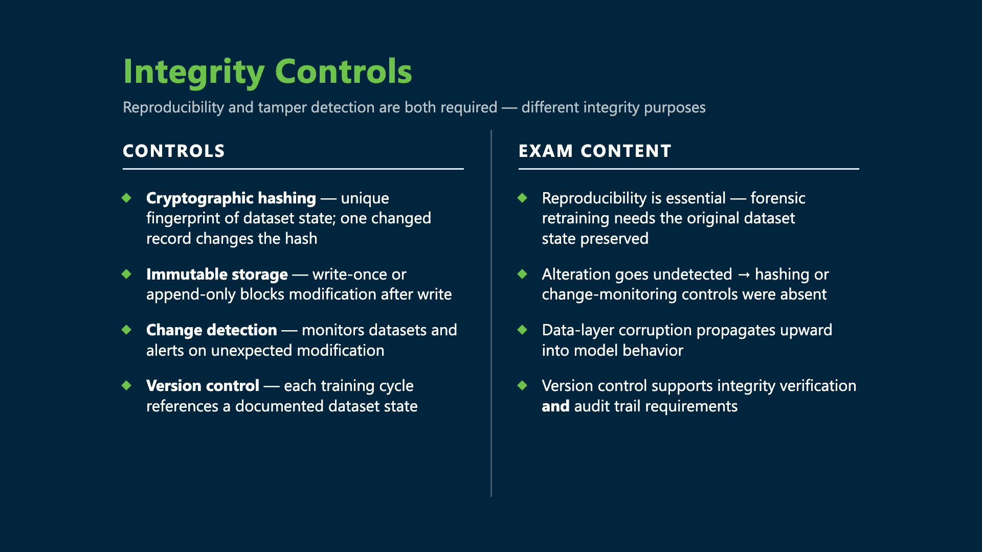
Integrity Controls
Cryptographic hashing fingerprints dataset state
Immutable / write-once storage; change-detection alerts
Version control for reproducible dataset states
Reproducibility is essential for forensic retraining

Slide 37
Output Protection
Output validation — unaltered before users/workflows
Secure logging — append-only, timestamped, verifiable
Digital signatures on high-value outputs
Altered AI evidence = insufficient logging integrity

Slide 38
Authenticity & Provenance
Watermarking distinguishes authentic from manipulated output
Provenance tracks dataset origin + training lineage
Detect unauthorized model reuse via provenance comparison

Slide 39
Continuous Integrity Monitoring
Anomaly detection on datasets, configs, parameters
Drift without authorized retraining may signal tampering
Rollback to known-good states; integrate with incident response
Detection alone is insufficient without restoration

Slide 40
Recap · Data Management
Data-governance policy program connections
Provenance is immutable + required for the license register
Data poisoning = Category A — the highest-impact attack
Five data-poisoning response steps

Slide 41
Privacy, Ethical & Trust Controls
Chapter 06 · Episode 3 — Dr. Michael Solomon

Slide 42
ASPIRATIONAL vs TESTABLE
Every principle needs a testable control
Five elements: control, metric, threshold, cadence, owner
Principles without these are just intentions

Slide 43
Five Responsible-AI Principles
Fairness
Transparency
Privacy
Explainability
Accountability

Slide 44
Fairness
Demographic parity — equal positive-outcome rates
Equal opportunity — equal error rates (esp. false negatives)
Violated when rates differ without legitimate justification
e.g. fraud flagging skewed across groups

Slide 45
Transparency
Communicate existence, purpose, capabilities, limits
Not full disclosure of model internals
Regulated: credit, healthcare, employment
Violated when decision-making is hidden

Slide 46
Privacy — Three AI-Specific Risks
Inference attacks — infer sensitive attributes
Training-data memorization — reproduce personal data
Re-identification of anonymized data via correlation
Privacy by design: minimization, purpose limits, consent

Slide 47
Explainability
Meaningful human account of a specific decision
Explainability ≠ interpretability (full internals)
LIME — local approximation with a simpler model
SHAP — feature-contribution scores via game theory

Slide 48
Accountability
Clear role ownership + audit trails
Governance that attributes decisions to responsible parties
Completes the responsible-AI framework

Slide 49
Demo · Responsible-AI Scorecard
Evaluate an AI system against all five principles in Google Colab — fairness (parity + equal opportunity), the three privacy risks, and LIME/SHAP — producing a compliance scorecard.

Slide 51
Exam Tips
Five principles — definition, implementation, violation each
Fairness: demographic parity vs equal opportunity
Privacy: three risks beyond compliance
LIME (local approx) vs SHAP (feature contribution)

Slide 52
FAIRNESS WITHOUT A METRIC = INTENT
Governance obligations with legal grounding
Explainability without testing fails Article 22
Two legal explainability obligations — documented per system

Slide 53
Legal Explainability Obligations
GDPR Article 22 — meaningful explanation for automated decisions
EU AI Act — inform individuals + provide the logic
A SHAP viz that isn't plain language fails Article 22

Slide 54
Six Documentation Requirements
Responsible-AI policy with testable controls
Fairness-assessment record
DPA + FRIA together
Explainability-mechanism specification
Trustworthiness assessment + ethics-review record

Slide 55
DPA + FRIA & US Context
DPA + FRIA both required for high-risk personal data
Neither substitutes for the other
US: no direct Article 22 equivalent — FCRA adverse-action closest
EEOC + California CPRA add automated-decision rights

Slide 56
Control Selection, Implementation & Lifecycle
Chapter 06 · Episode 4 — Dr. Michael Solomon

Slide 57
The Control Flow
Select → specify → implement
Measure → review → retire
Unbaselined control = intention, not evidence

Slide 58
Selection Criteria 1–4
RISK COVERAGE
REG ALIGNMENT
Maps to a risk register entry
EU AI Act · GDPR · sector
LAYER SCOPE
PROPORTIONALITY
Which of 4 architecture layers
Cost/complexity fits the tier

Slide 59
Selection Criteria 5–6
5 Measurability — needs a KPI/KRI
6 Interaction effects — document deps
No KPI/KRI = no demonstration
Silent dependency failure = false assurance

Slide 60
Four Control Layers (≥2 each)
RISK COVERAGE
REG ALIGNMENT
LAYER SCOPE
PROPORTIONALITY
Maps to a risk register entry
EU AI Act · GDPR · sector
Which of 4 architecture layers
Cost/complexity fits the tier

Slide 61
Implementation Plan
1 Spec — design · monitors · pass/fail
2 Ownership — a named owner
3 Acceptance + baseline
4 Dependencies + fallback
5 Evidence + audit trail

Slide 62
KPI vs KRI
KPI
Control performance
e.g. 99%+ logged
Below → investigate
KRI
Residual risk
e.g. log gaps / 7 days
Predefined thresholds

Slide 63
Six Lifecycle Phases
1 Design→spec
2 Implement→baseline
3 Monitor→monthly reports
4 Assess→effectiveness (annual/bi-annual)
5 Enhance→change record
6 Retire→sign-off

Slide 64
Three Control Gaps
Unimplemented — 4 required elements
Failed — treat as an incident
Vendor-dependent — DD + contract
Unimplemented needs all four elements

Slide 65
Four Lifecycle Failures
NO RISK BASIS
GAP UNDOCUMENTED
Controls with no register entry
Deferred, no register entry
NO BASELINE
NOT REVIEWED
Can't tell normal from degraded
Drift undetected for years

Slide 66
The Fixes + Recap
Selection starts from the risk register
Baseline before claiming it works
Undocumented gap = governance failure
Annual (tier-1) / bi-annual (tier-2/3) review

Slide 67
Security Monitoring Metrics & Threat Controls Mapping
Chapter 06 · Episode 5 — Dr. Michael Solomon

Slide 68
The Monitoring Dashboard
Integrates KPIs + KRIs from all six modules
Monitoring earns value only when it drives decisions
Closes Module 6 and the full course

Slide 69
Dashboard · Modules 1–3
M1 Governance — policy-review %; risk entries >90 days
M2 Data — assets with a current model card
M3 Security — controls with active KPIs

Slide 70
Dashboard · Modules 4–6
M4 Incident/Risk — mean time to detect & contain
M5 Vendor — third-party monitoring completion
M6 Controls — % controls meeting baseline

Slide 71
Six AI-Specific SIEM Sources
Inference logs
Training-pipeline logs
Model-registry audit logs
API-gateway logs
Fairness metrics
UEBA AI baselines

Slide 72
Six Detection Rule Categories
Prompt injection
Model extraction
Training-data anomalies
Output anomalies
Insider threat
Supply-chain alerts

Slide 73
Seven MITRE ATLAS Threat Mappings
ML supply-chain compromise
Data poisoning
Model evasion
Model extraction
Prompt injection
Insider threat
Membership inference

Slide 74
UNMANAGED RISK
Each threat needs a primary control, a detection control + documented residual risk
Threat + no risk-register entry = unmanaged risk

Slide 75
Four Monitoring Maturity Levels
L1 Reactive
L2 Basic
L3 Active
L4 Assurance
Post-harm; no continuous evidence
Delayed periodic evidence only
Continuous KPI/KRI + alerts — EU AI Act min
Predictive, self-improving; strongest evidence

Slide 76
Monitoring Cycle · Steps 1–3
1 Collect — six SIEM sources, documented in plan
2 Detect — rules + correlation raise alerts
3 Analyze — triage, classify, record findings

Slide 77
Monitoring Cycle · Steps 4–6
4 Respond — IR + risk-register updates, logged
5 Report — monthly / quarterly / board cadence
6 Improve — tune rules, add sources

Slide 78
IMPROVE = L3 → L4
Self-improvement is the maturity signal
The improve step distinguishes Level 3 from Level 4

Slide 79
Module 6 Complete — The Thread
Testing & TEVV
Data management & poisoning
Privacy, ethics & trust
Control lifecycle
Monitoring & controls mapping

Slide 80
Governance Documents = Evidence
Asset inventory — proves what you govern
Risk register — proves you assessed it
Control specs — prove you addressed it
Monitoring records — prove you maintained it

Slide 81
The Program Must / Must Not
Start every control from the risk register
Treat V&V completion as a deployment gate
Not accept "publicly available" as a license
Not treat model updates as software patches

Slide 82
What the Exam Tests
Provider vs deployer + 4 deemed-provider cases
TEVV vs V&V; 6 control-lifecycle phases
6 monitoring-cycle steps; 5 poisoning-response steps
8 architecture-review checklist items

